Slide 1
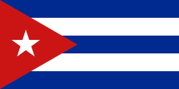
cuba
Political Freedom and Economic sanctions
By: Huda bargoth

Slide 2
Cuba's background
In cuban culture they dance son cubano and rumba and they dance a lot and have street parties and even have a tradition called Havana carnival. Not only that but there's many other traditions which are santeria it's a religious tradition also includes african and catholic. In cuba the people there speak spanish. people in Cuba speak Spanish, but it's also kinda different because in cuba they have an accent and their spanish is called cuban spanish because Cuban Spanish sounds a little different from the Spanish spoken in Spain because again it has its own accent

